Slide 1
Car rental system
Presented by:
Ali Hamza
Siddeeq Tahir
Husnain Zia

Slide 2
Technologies used
Html
Css
Javascript

Slide 3
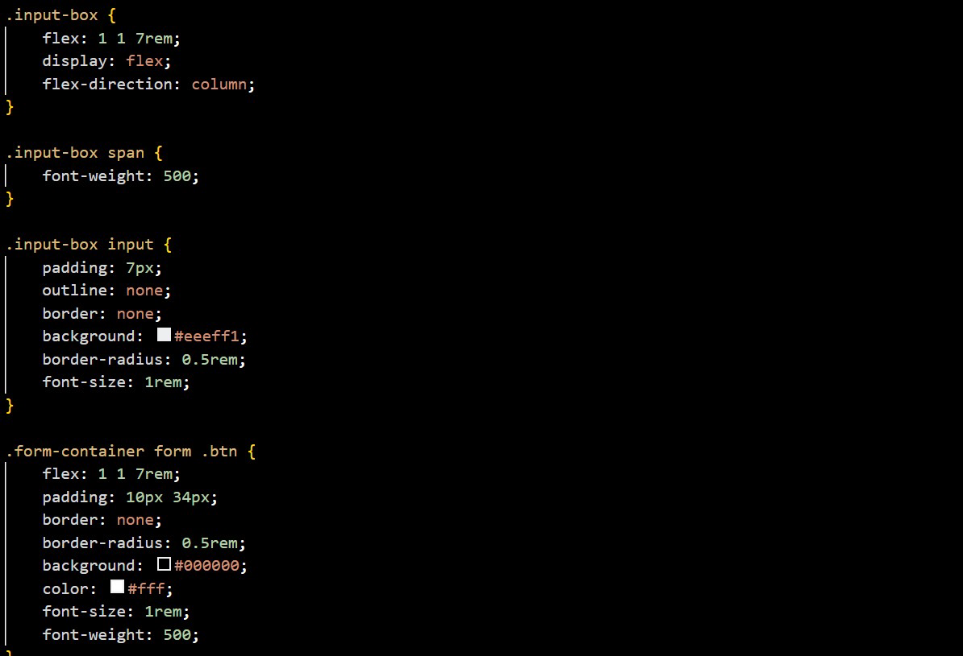
Frontend and backend code

Slide 4
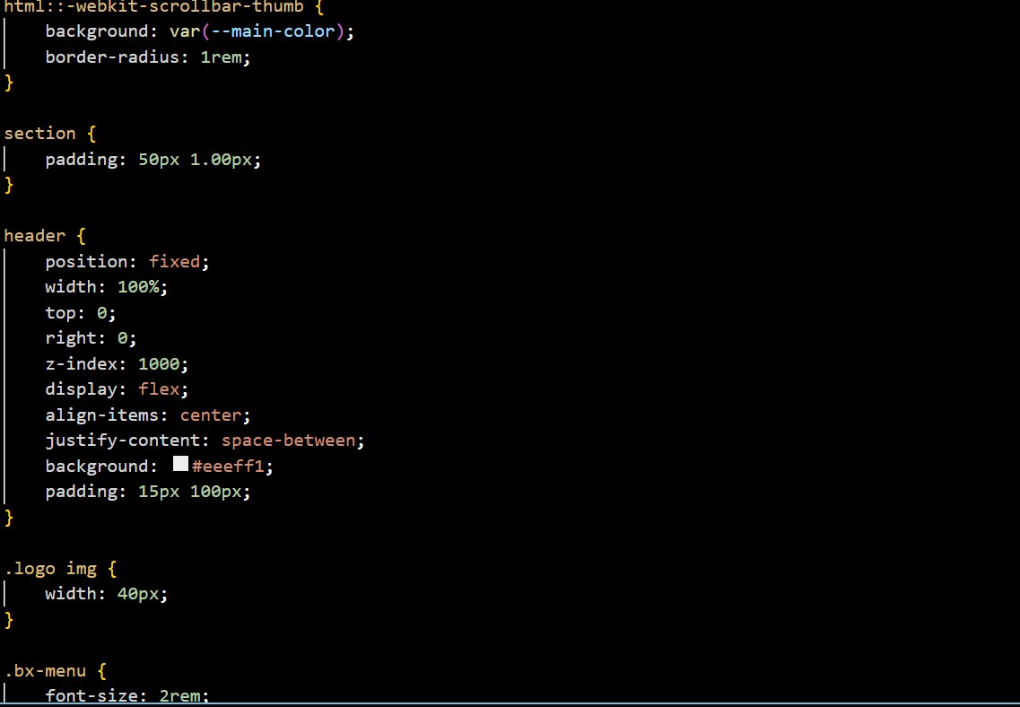
Cont.

Slide 5
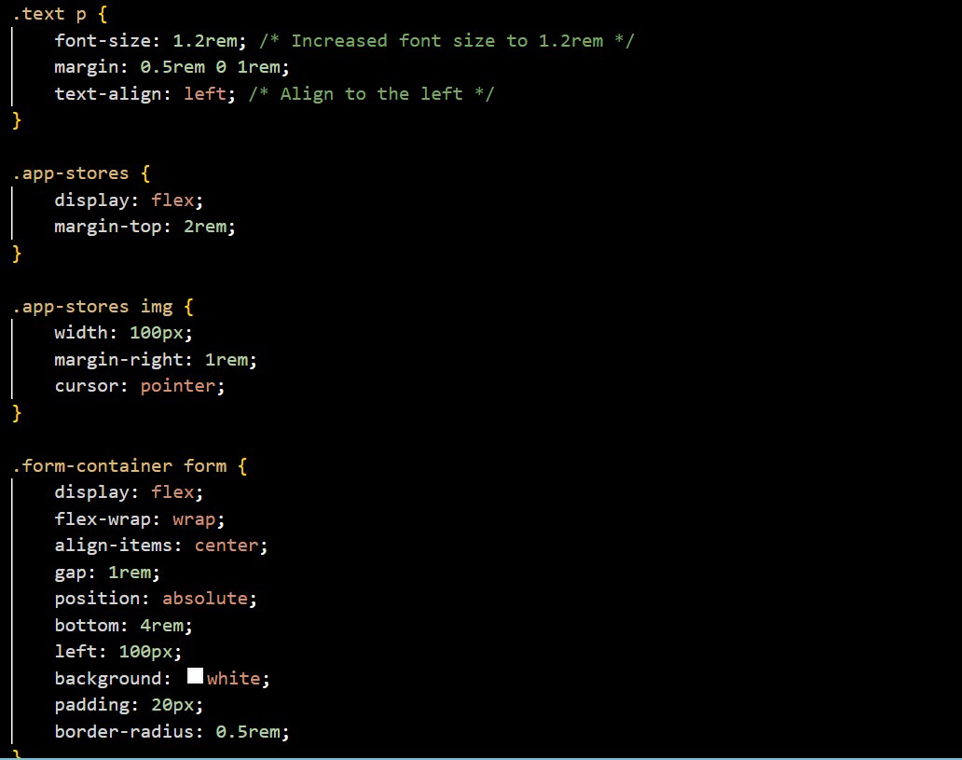
Cont.

Slide 6
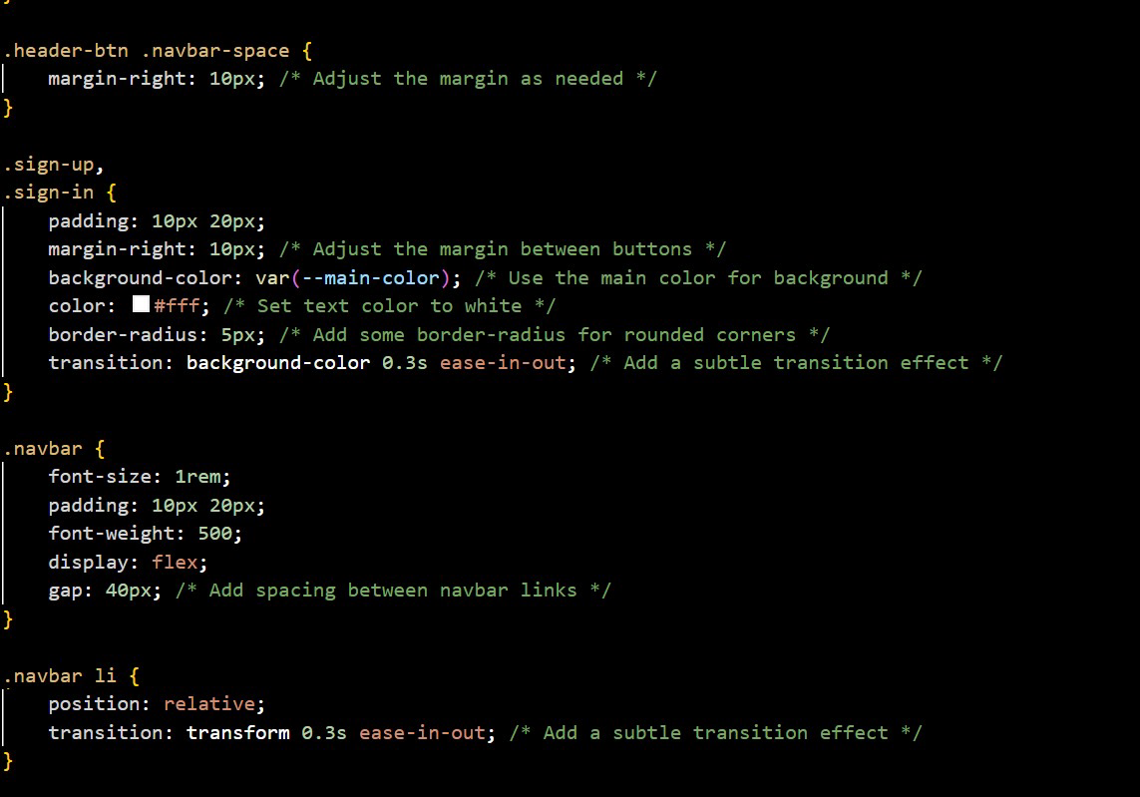
Cont.

Slide 7
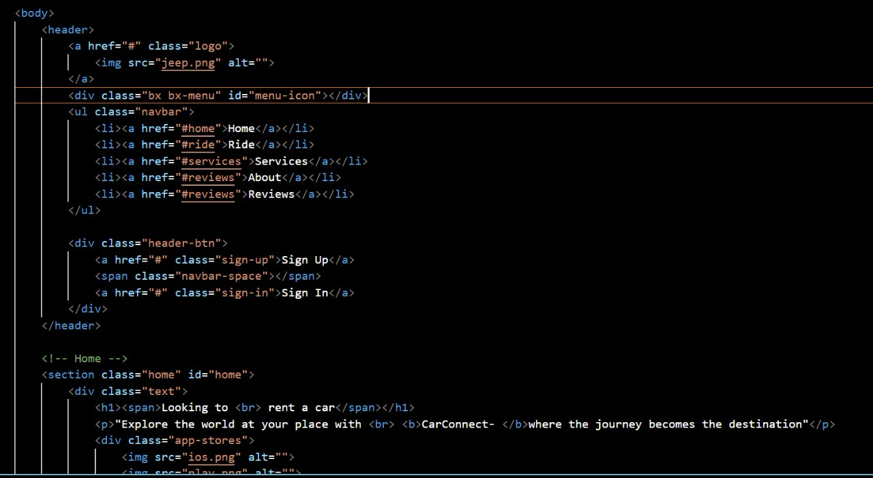
Cont.

Slide 8
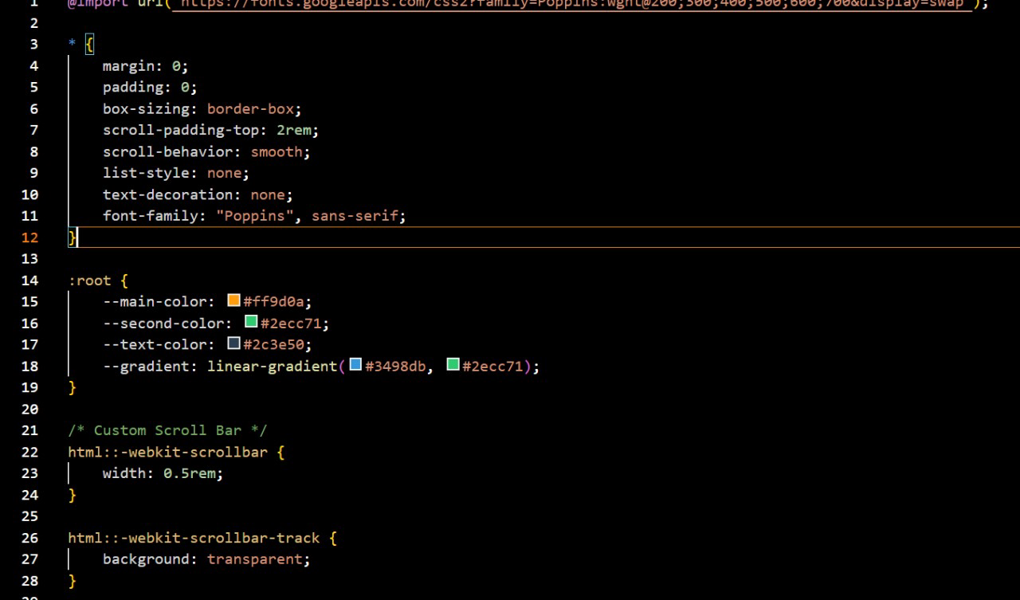
Cont.

Slide 9
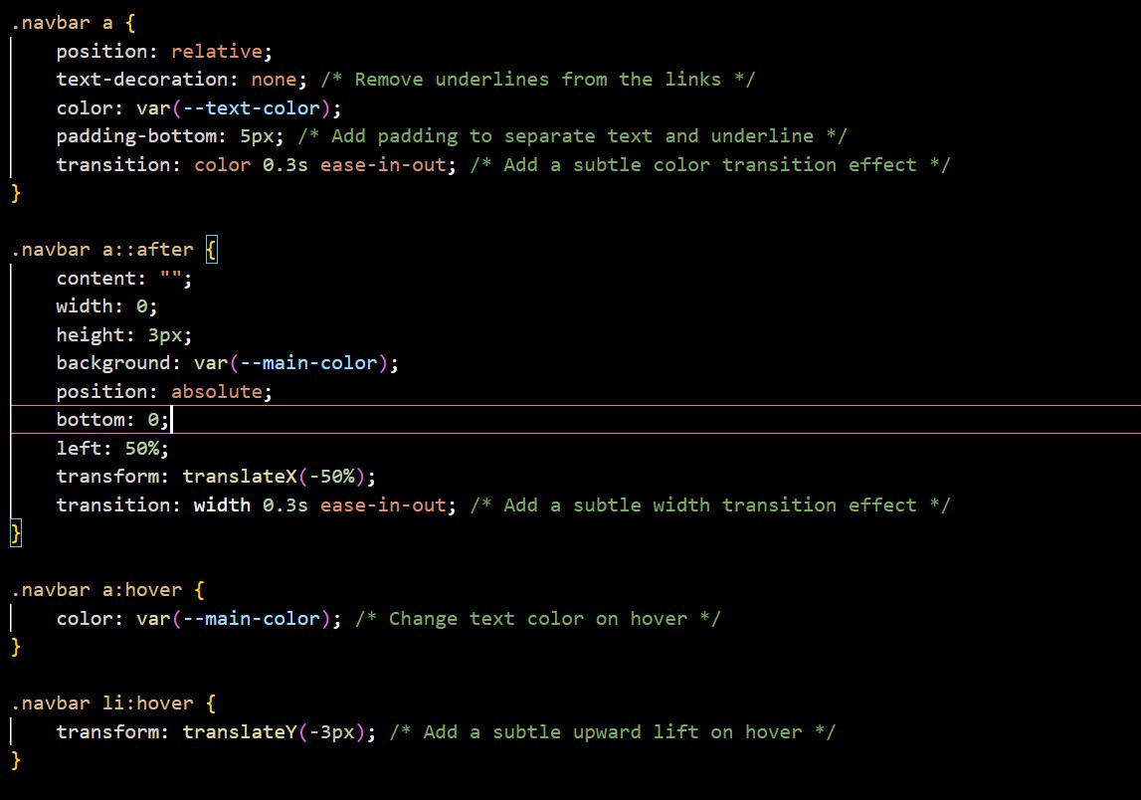
Cont.

Slide 10
The End

